Slide 1
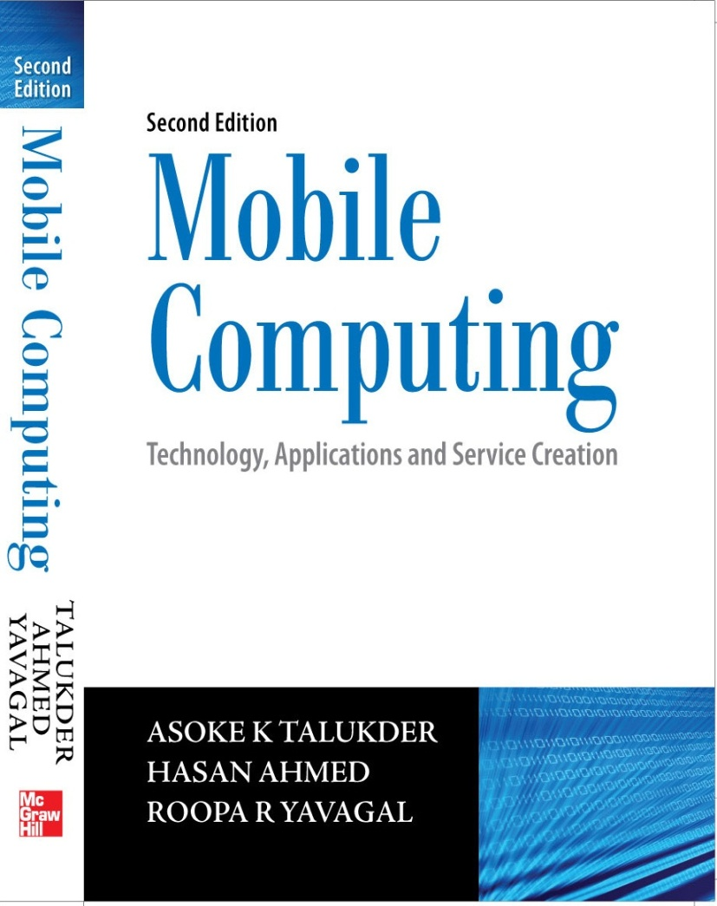
Notes#7
Short Message Service (SMS)

Slide 2
Short Message Service (SMS)
Most popular data bearer/service within GSM
More than one billion SMS messages interchanged everyday with a growth of more than half a billion every month on an average
Runs on SS7 signaling channels, which are always present but mostly unused, be it during an active user connection or in the idle state
Each short message is up to 160 characters in length when 7-bit English characters are used and 140 octets when 8-bit characters are used

Slide 3
Strengths of SMS
Omnibus nature of SMS: SMS uses SS7 signaling channel which is available throughout the world.
Stateless: SMS is session-less and stateless as every SMS message is unidirectional and independent of any context. This makes SMS the best bearer for notifications, alerts and paging.
Asynchronous: SMS is completely asynchronous. In case of SMS, even if the recipient is out of service, the transmission will not be abandoned and hence, SMS can be used as message queues. SMS can be used as a transport bearer for both synchronous (transaction oriented) and asynchronous (message queue and notification) information exchange.

Slide 4
Strengths of SMS
Self-configurable and last mile problem resistant: SMS is self-configurable and subscriber is always connected to the SMS bearer irrespective of the home and visiting network configurations.
Non-repudiable: SMS message carries the Service Center (SC) and the source MSISDN as a part of the message header through which any SMS can prove beyond doubt its origin.
Always connected: As SMS uses the SS7 signaling channel for its data traffic, the bearer media is always on. Users cannot switch OFF, BAR or DIVERT any SMS message. SMS message is delivered to the Mobile Station (MS) without any interruption to the ongoing call.

Slide 5
SMS Architecture
Two types of SMS - SM MT (Short Message Mobile Terminated Point-to-Point) and SM MO (Short Message Mobile Originated Point-to-Point)
SM MT is an incoming short message from the network and is terminated in the MS
SM MO is an outgoing message originated in the MS and forwarded to the network for delivery
For an outgoing message, the path is from MS to SC via the VLR and the IWMSC (Inter Working MSC) function of the serving MSC whereas for an incoming message the path is from SC to the MS via HLR and the GMSC (Gateway MSC) function of the home MSC

Slide 6
Strengths of SMS
Omnibus nature of SMS: SMS uses SS7 signaling channel which is available throughout the world.
Stateless: SMS is session-less and stateless as every SMS message is unidirectional and independent of any context. This makes SMS the best bearer for notifications, alerts and paging.
Asynchronous: SMS is completely asynchronous. In case of SMS, even if the recipient is out of service, the transmission will not be abandoned and hence, SMS can be used as message queues. SMS can be used as a transport bearer for both synchronous (transaction oriented) and asynchronous (message queue and notification) information exchange.

Slide 7
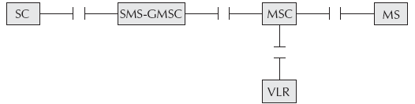
Short Message Mobile Terminated (SMMT)
Message is sent from SC to the MS.
For the delivery of MT or incoming SMS messages, the SC of the serving network is never used which implies that a SMS message can be sent from any SC in any network to a GSM phone anywhere in the world.
Interfaces in SMMT

Slide 8
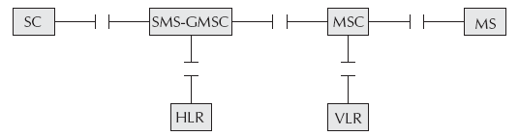
Short Message Mobile Originated
For a MO message, the MSC forwards the message to the home SC.
MO message works in two asynchronous phases. In the first phase, the message is sent from the MS to the home SC as a MO message. In the second phase, the message is sent from the home SC to the MS as a MT message.
Interfaces in SMMO

Slide 9
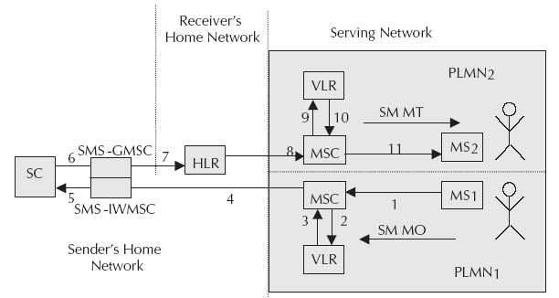
SMS Transfer

Slide 10
SMS as an Information Bearer
For using SMS as an information bearer, we need to connect the services running on the Enterprise Origin server to the SC through an SME (Short Message Entity) or ESME (External Short Message Entity).
SME in any network is generally a SMS gateway.
With respect to SMS, a GSM subscriber is always in control of the SC in the home network irrespective of the serving network.
If there is any SMS-based data service in the home network, it will be available in any foreign network.

Slide 11
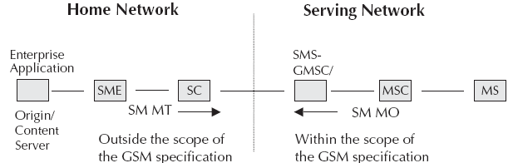
SMS as an Information Bearer

Slide 12
Operator Centric Pull
Operators offer different information on demand and entertainment services through connecting an Origin server to the SC via a SMS gateway.
Such service providers are known as Mobile Virtual Network Operator(s) (MVNO).
MVNOs develop different systems, services and applications to offer data services using SMS.
Many enterprises use MVNOs to make their services available to mobile phone users.

Slide 13
Example of MVNO
Let’s say few banks offer balance enquiry and other low security banking services over SMS and customers need to register for the service.
During the registration, the customer needs to mention the MSISDN of the phone which will be used for a banking service.
Once a user is registered for the service, he enters ‘BAL’ and sends the message to a service number (like 333) as a MO message and then SC delivers this MO message to the SMS gateway (known as SME-Short Message Entity) connected to this service number.

Slide 14
Example of MVNO
SMS gateway then forwards this message to the enterprise application and response from the enterprise application is delivered to the MS as a MT message from the SME.
Even if the subscriber is in some remote region of a foreign network within GSM coverage, he can send the same SMS to the same service number in his home network and this makes the home services available in the foreign network. Hence, operator-centric SMS pull service is completely ubiquitous.

Slide 15
Operator Centric Pull
Connectivity between SME and Origin server could be anything like SOAP (Simple Object Access Protocol), direct connection through TCP socket or through HTTP.
There are applications where SMS is used in session oriented transactions as ‘SMS chat’ and ‘SMS contests’ need to remember the user context over multiple transactions.

Slide 16
Operator Independent Push
Any push, which may be an alert, notification or even response from a pull message generated by an application, can be serviced by any network and delivered to any GSM phone in any network without any difficulty.
If appropriate roaming tie-ups are in place, an enterprise can use SMS to send business alerts or proactive notifications to its customer anywhere, anytime on his phone.

Slide 17
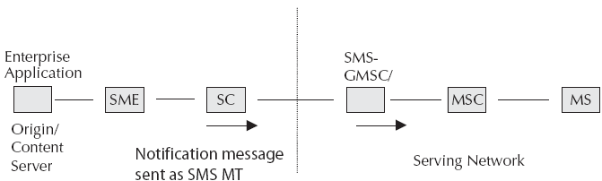
Operator Independent Push

Slide 18
Operator Independent Pull
For a SMS message to be routed to some enterprise SME connected to external SC, SAT is used.
SAT application running on the SIM card changes the SC number during the transmission of the SMS and forces the SMS to recognize a different SC of a different network as its home SC.
Here, too, SMS is sent to the SME connected to the home SC. If a SMS service is operator dependent, the cellular operator can use this to its advantage.
Enterprises need operator independent pull as enterprises have customers around the world subscribing to different GSM networks
Above scenario can also be achieved through Intelligent Network.

Slide 19
Value Added Services through SMS
Value Added Services (VAS) can be defined as services, which share one or more of the following characteristics:
Supplementary service (not a part of basic service) but adds value to total service offering
Stimulates incremental demand for core services offering
Stands alone in terms of profitability and revenue generation potential
Can sometimes stand-alone operationally
Does not cannibalize basic service unless clearly favorable

Slide 20
Value Added Services through SMS
Can be an add-on to basic service, and as such, may be sold at a premium price
May provide operational and/or administrative synergy between or among other services and not merely for diversification

Slide 21
Value Added Services through SMS
VAS over SMS are entertainment and information on demand which is further categorized into:
Static information which does not change frequently
Dynamic information which changes in days
Real-time information which changes continually
Some of the common VAS examples are:
News/Stock Quotes Service
Session-based Chat Application
Email through SMS
Health Care Services
Micro-Payment Services

Slide 22
Alert services through VAS
Proactive alert services can be of the two kinds – Time based and Watermark based
Time based proactive alerts are sent to the mobile phone at a pre-assigned time of the day
Watermark based proactive alerts are sent when some event occurs

Slide 23
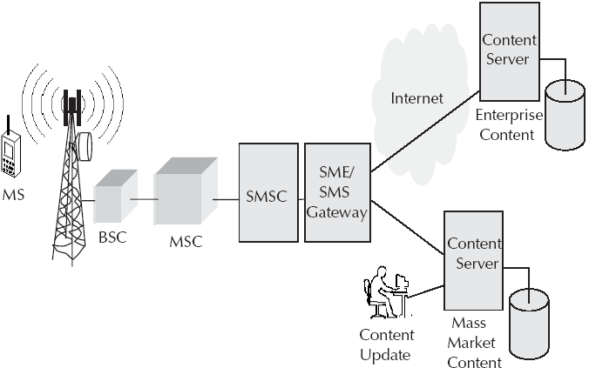
VAS Architecture

Slide 24
Location based services through SMS
Location based services could be road direction, restaurant guide, shopping alerts, etc.
In location based services, only the information relevant to the current location of the mobile phone (or the subscriber) is provided.
The location of a mobile phone can be determined either from the network or from the device.
The location of a mobile phone can be determined either from the network or from the device.
To find out the location from the device either of the following technologies are used - Cell ID (CID) based system and Global Positioning System (GPS) based system.

Slide 25
Cell ID based system
CID of the current BTS is determined and then mapping of the cell identifier to the geographical location is performed.
For CID based system, the signal strength from all the different CIDs are extracted from the device and sent to the server through a SMS.
Location of the user is determined using the signal strength and triangulation algorithms.

Slide 26
GPS based system
GPS is Global Positioning System.
Location is determined through a GPS receiver installed within the phone.
GPS provides facility to compute position, velocity and time of a GPS receiver.
GPS based system is not dependent on the network operator.

Slide 27
Accessing the SMS bearer
There are two ways through which SMS bearer can be accessed:
Using a mobile phone as a GSM modem and connecting it to the computer
Using the SMSC of an operator through SMPP or similar interface

Slide 28
GSM Modem
Normal cell phone can be used as a data modem which will be in a position to access the network as a normal GSM phone.
Once phone and computer is connected (through wired or wireless means), cell phone can be used as an external GSM modem and issue AT commands to transact data over the GSM/SMS bearer. AT in Hayes terminology is known as attention and are commands to the modem from the computer.
AT commands can be for sending a SMS, reading a SMS, checking battery power, writing a phone book entry, etc.
To read a SMS from the GSM modem, we need to ensure that the SMS is forwarded to the computer rather than the phone local store and for this CNMI commands are used.

Slide 29
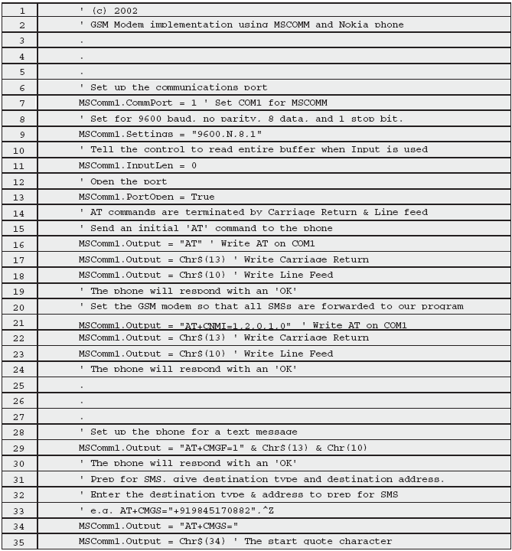
Example code for GSM

Slide 30
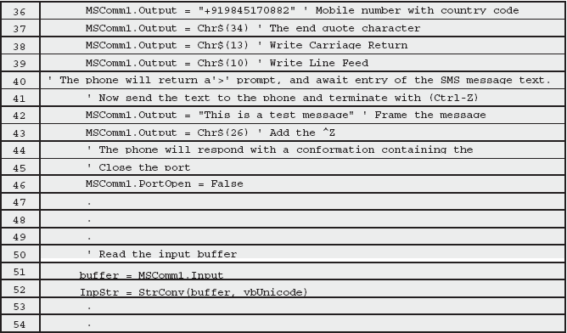
Example code for GSM

Slide 31
Example code for GSM
Code is written in Visual Basic and uses Microsoftmscomm controls. The mscomm controls use the COM1 port for communication.
Line 13 is for setting of the communication port and the interface between the computer and the modem.
Lines 14–24 are for initialization of the GSM phone as modem.
Lines 28–46 are to send a SMS.
Lines 50–52 are for reading SMS from the modem.

Slide 32
SMPP
Short Message Peer to Peer (SMPP) protocol
Open, industry standard protocol designed to provide a flexible data communications interface for transfer of short message data between a Message Center (SC or SMSC) and a VAS application such as a WAP Proxy Server, Voice Mail server, E-Mail Gateway or any other Messaging Gateway
SMPP client is termed a External Short Message Entity (ESME) and is connected to the SC
SMPP release v3.4 presently supports Digital Cellular Network technologies which include GSM, IS-95 (CDMA), CDMA 1X/CDMA 2000, ANSI-136 (TDMA) and IDEN

Slide 33
SMPP
SMPP supports a full featured set of two way messaging functions such as:
Transmit messages from an ESME to single or multiple destinations via the SMSC
An ESME may receive messages via the SMSC from other SMEs
Query the status of a short message stored on the SMSC
Cancel or replace a short message stored on the SMSC
Send a registered short message
Schedule the message delivery date and time

Slide 34
SMPP
Select the message mode such as datagram or store and forward
Set the delivery priority of the short message
Define the data-coding type of the short message
Set the short message validity period
Associate a service type with each message such as voice mail notification

Slide 35
SMPP
Open message transfer protocol that enables short message entities (SMEs) outside the mobile network to interface with an SC and non-mobile entities that submit messages to, or receive messages from an SMSC are known as External Short Message Entities (ESMEs)
The SMPP protocol defines operations and data as:
Set of operations for the exchange of short messages between an ESME and an SMSC
Data that an ESME application must exchange with an SMSC during SMPP operations

Slide 36
SMPP
Subscribers to an SMS capable Cellular Network may receive short messages on a Mobile Station (MS) from one or more ESMEs
Examples of such ESME applications can be:
Voice mail alerts originating from a VMS (Voice Messaging System)
Numeric and alphanumeric paging services
Informative services
Calls directly dialed or diverted to a message-bureau operator, who forwards the message to the SMSC, for onward delivery to a subscriber’s handset

Slide 37
SMPP
Fleet management applications that enable a central station to use the SMSC to determine the location of its service vehicles and notify the closest vehicle of a service request in their area
Telemetry applications
WAP Proxy Server

Slide 38
Kannel
Open source SMS gateway
Kannel gateway also supports WAP and MMS (Multi Media Messaging) interfaces
Offers HTTP interface for message transfer and administrating of the gateway
Kannel divides its various functions into different kinds of processes (figure ahead) called boxes, based on what kinds of external agents it needs to interact with
Bearerbox implements the bearer level of SMS and as a part of this, it connects to the SMS centers
Definitions of different TCP/IP ports, usernames, passwords, etc. are required to be defined for Bearerbox connection

Slide 39
Kannel
Smsbox implements the rest of the SMS gateway functionality and as a part of this it receives textual SMS messages from the bearerbox and interprets them as service requests and responds to them in the appropriate way
All the services are handled and managed by Smsbox
There can be only one bearerbox, but any number of Smsboxes in a single Kannel instance
While it is possible to have each SMS center served by a different process, it has been deemed not to give enough extra reliability or scalability to warrant the complexity
Each box is internally multithreaded

Slide 40
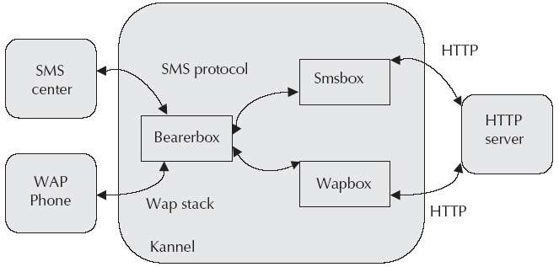
Kannel Architecture

Slide 41
Pull messages in Kannel
User enters a message with a keyword and then sends the same to a service number.
During binding of the SMS gateway, we intimate the SC that we are listening for a service number. Therefore, all the messages sent to a service number will be routed to our SMPP gateway.
In the Kannel configuration file, we mention that whenever there is a message with a particular keyword, it should be forwarded to a HTTP URL.
To service the user with appropriate response, we need to know the request with all the parameters and the MSISDN number of the phone. These are transferred from Kannel gateway to the URL through %a and %p.

Slide 42
Pull messages in Kannel
The response of the http request will be forwarded directly to the user by Kannel gateway.
If the response from the content/origin server is more than 160 characters, Kannel splits the message into multiple messages.
The max message parameter defines the limit of maximum number of messages as response. If we set the max messages to 0, no response will be sent to the user, though there could be some response coming from the HTTP request.

Slide 43
Push messages in Kannel
Message is sent through HTTP interface as well and an application uses an HTTP URL to communicate with the Kannel gateway and to send SMS messages
Kannel delivers these messages to the SC
To offer certain level of security, Kannel allows the user authentication through user identifier and a password to access such URLs

Slide 44
Next Chapter
General Packet Radio Service (GPRS)
Thanks

